Slide 1
Splice Site Prediction
Using modern NLP model

Slide 2
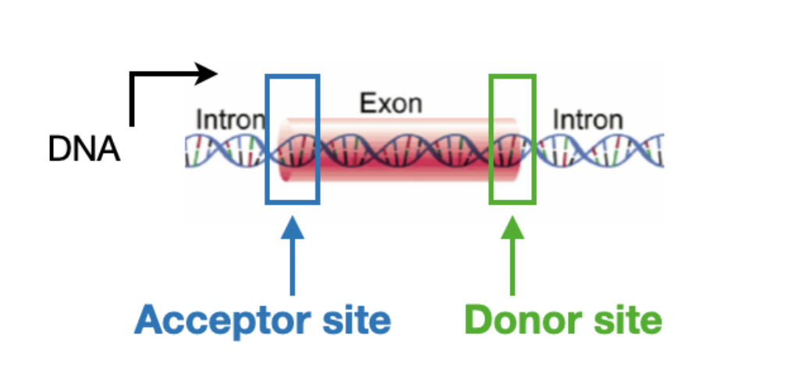
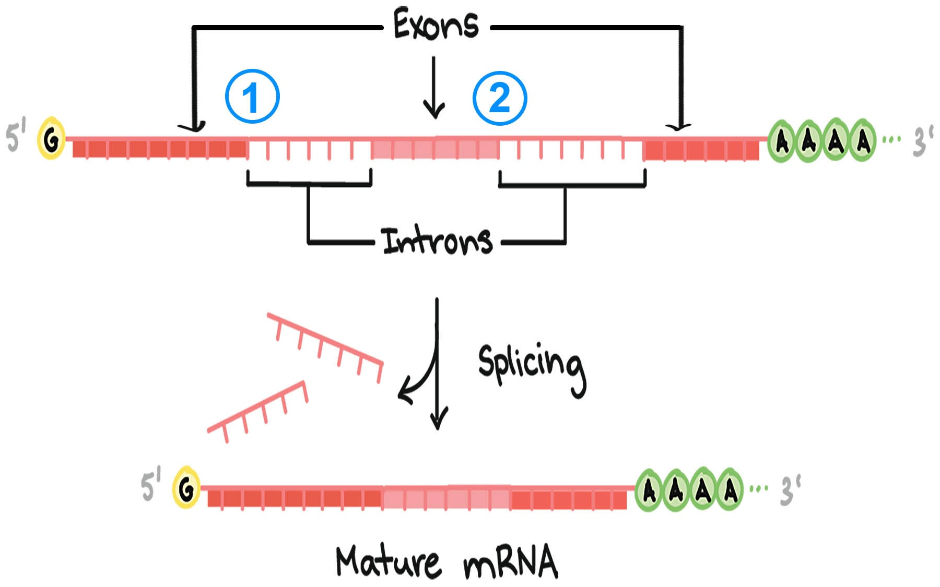
Splice Sites

Slide 3
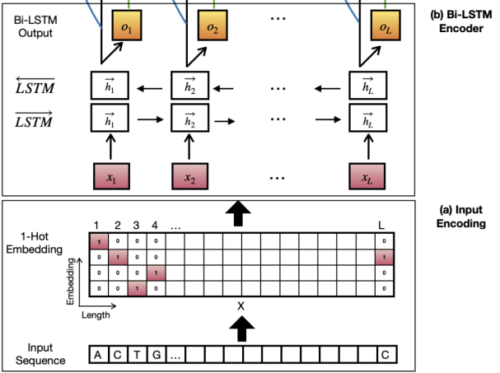
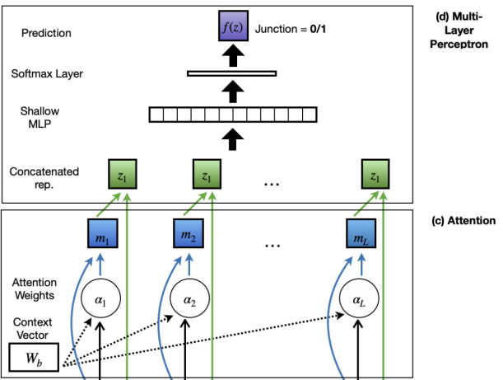
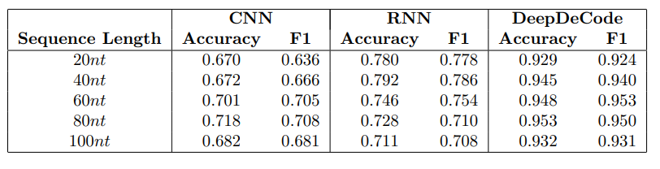
DeepDeCode Model
Paper Link
Github Repository

Slide 4
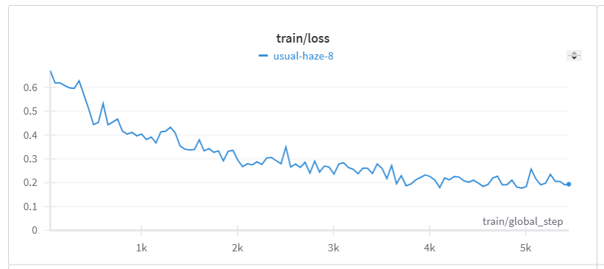
Our Model (Fine-Tuned)
DNABERT-2-117M
Accuracy | F1 | Precision | Recall | Loss
0.929 | 0.928 | 0.928 | 0.928 | 0.22
DNABERT-2 Paper Link
Github Repository

Slide 5
Our Data Pipeline
GRCH38.p14
Gene Annotations
(GTF Format)
Human Chromsome Genes
(FASTA Format)
Preprocessing
Dataset Generation
Training The Model
Python3.12
Requirements included in Github Repository

Slide 6
Our Project

